Slide 1
Summary of Lecture 1
Euler Theorem
Algorithm for Euler Circuit.
Basic techniques for designing algorithms:
greedy, divide-and-conquer, dynamic programming

Slide 2

Week 2: Greedy Algorithms
Notes:
Many Computer algorithms
But 3 Basic Techniques.

Slide 3
Greedy Algorithm
A technique to solve problems:
always makes the locally best choice at the moment (local optimal).
Hopefully, a series of locally best choices will lead to a globally best solution.
Greedy algorithms yield optimal solutions for many (but not all) problems.

Slide 4
Interval Scheduling

Slide 5
Interval Scheduling
Interval scheduling.
Job j starts at s_{j} and finishes at f_{j}.
Two jobs compatible if they don't overlap.
Goal: find maximum subset of mutually compatible jobs.
a
Examples: {a, g} is a set of mutually compatible jobs.
{b, e, h} is also a set of mutually compatible jobs.
b
c
d
e
f
g
h
Time
0
1
2
3
4
5
6
7
8
9
10
11
Notes:
Activity selection = interval scheduling
OPT = B, E, H
Note: smallest job (C) is not in any optimal solution, job that starts first (A) is not in any optimal solution.

Slide 6
Ideas for Interval Scheduling
Greedy Algorithm: sort all the jobs in a list using a ‘greedy’ principle, and then choose it one by one
What are possible rules for greedy sorting?
Choose the interval that starts earliest.
Rationale: start using the resource as soon as possible.
Choose the smallest interval.
Rationale: try to have lots of small jobs.
Choose the interval that overlaps (conflicts) with the fewest remaining intervals.
Rationale: keep our options open and eliminate as few intervals as possible.

Slide 7
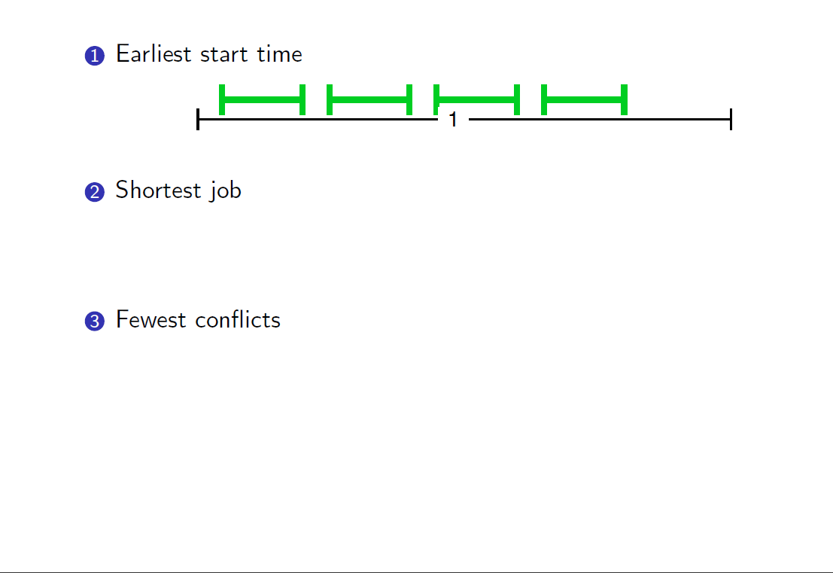
Rules That Don’t Work

Slide 8
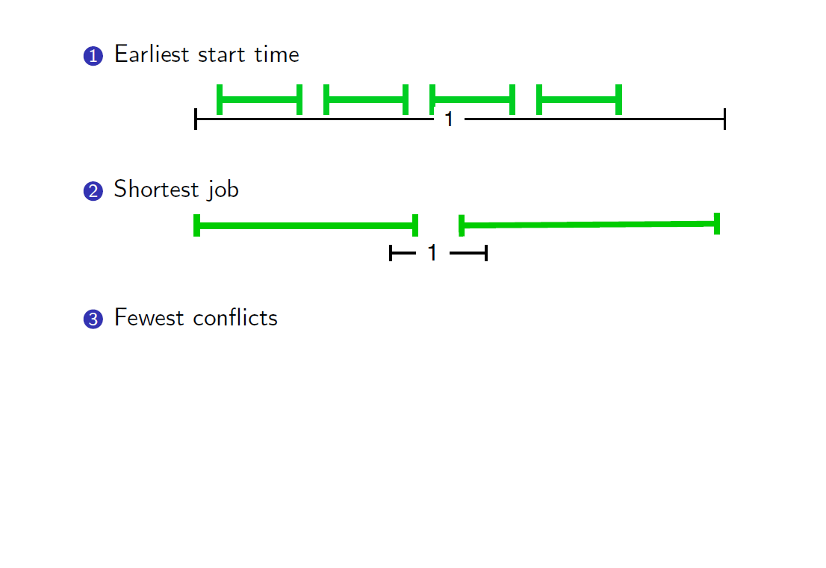
Rules That Don’t Work

Slide 9
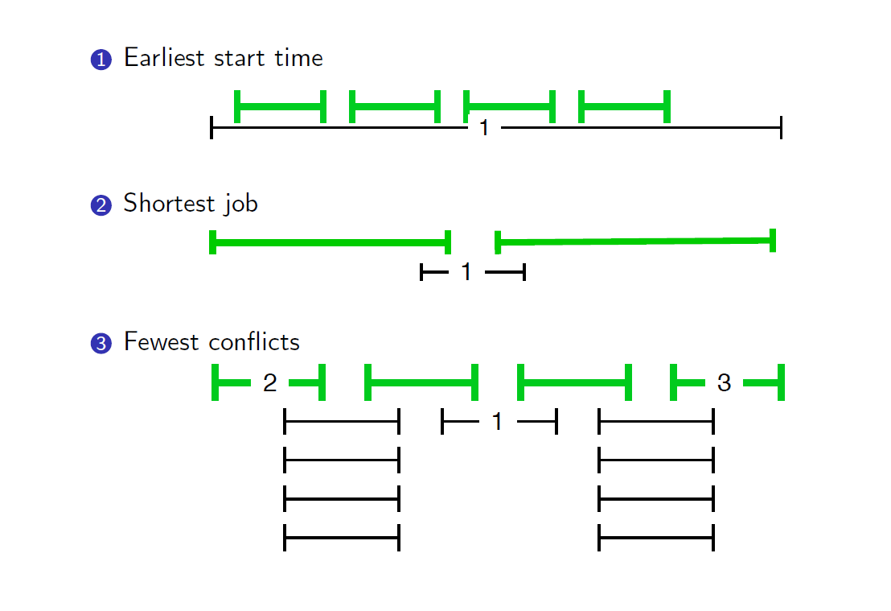
Rules That Don’t Work

Slide 10
Example: sort based on finish time
Jobs (s, f): (0, 10), (3, 4), (2, 8), (1, 5), (4, 5), (4, 8), (5, 6) (7,9).
Sorting based on f_{i}:
(3, 4) (1, 5), (4, 5) (5, 6) (4,8) (2,8) (7, 9)(0,10).
Selecting jobs:
(3, 4),
(4, 5),
(5, 6),
(7, 9),

Slide 11
Interval Scheduling: Greedy Algorithm
Greedy algorithm. Consider jobs in increasing order of finishing time. Take each job provided it's compatible with the ones already taken.
Implementation. O(n log n).
Remember job j* that was added last to A.
Job j is compatible with A if s_{j} ≥ f_{j*}.
Sort jobs by finish times so that f₁ ≤ f₂ ≤ ... ≤ f_{n}.
A ← φ
for j = 1 to n {
if (job j compatible with A)
A ← A ∪ {j}
}
return A
jobs selected
}how to decide if job j is compatible with A

Slide 12
How to Prove Optimality
How can we prove the schedule returned is optimal?
Let A be the schedule returned by this algorithm.
Let OPT be some optimal solution (there may be many optimal solutions!).
Might be hard to show that A = OPT, instead we need only to show that |A| = |OPT| or equivalently A is one of the optimal solutions.
Note the distinction: instead of proving directly that a choice of intervals A is the same as an optimal choice, we prove that it has the same number of intervals as an optimal. Therefore, it is optimal.

Slide 13
Interval Scheduling: Analysis
Theorem. Greedy algorithm is optimal.
Proof:
We compare the solution obtained from greedy algorithm with an optimal solution.
Let G=i1, i2, …, ik denote the set of jobs selected by greedy.
Let Opt=j1, j2, …, jn denote the set of jobs in the optimal solution.
The set of jobs are mutually compatible and the number of jobs is the largest.
Without loss of generality, we assume that
i1=j1, i2=j2, …, ir=jr and ir+1≠jr+1, where r could be 0, 1, 2, ….
Job ir+1 finishes before (or at the same time of ) jr+1 due to our greedy algorithm.
job i_{r+1} finishes before j_{r+1}
G:
i₁
i₁
i_{r}
i_{r+1}
OPT:
j₁
j₂
j_{r}
j_{r+1}
. . .

Slide 14
Interval Scheduling: Analysis
Theorem. Greedy algorithm is optimal.
Pf.
Let A=i₁, i₂, ... i_{k} denote set of jobs selected by greedy.
Let Opt=j₁, j₂, ... j_{m} denote set of jobs in the optimal solution with i₁ = j₁, i₂ = j₂, ..., i_{r} = j_{r} and i_{r+1} ≠ j_{r+1} (Note that r can be 0, 1, 2, …)
job i_{r+1} finishes before j_{r+1}
A:
i₁
i₁
i_{r}
i_{r+1}
OPT:
j₁
j₂
j_{r}
i_{r+1}
. . .

Slide 15
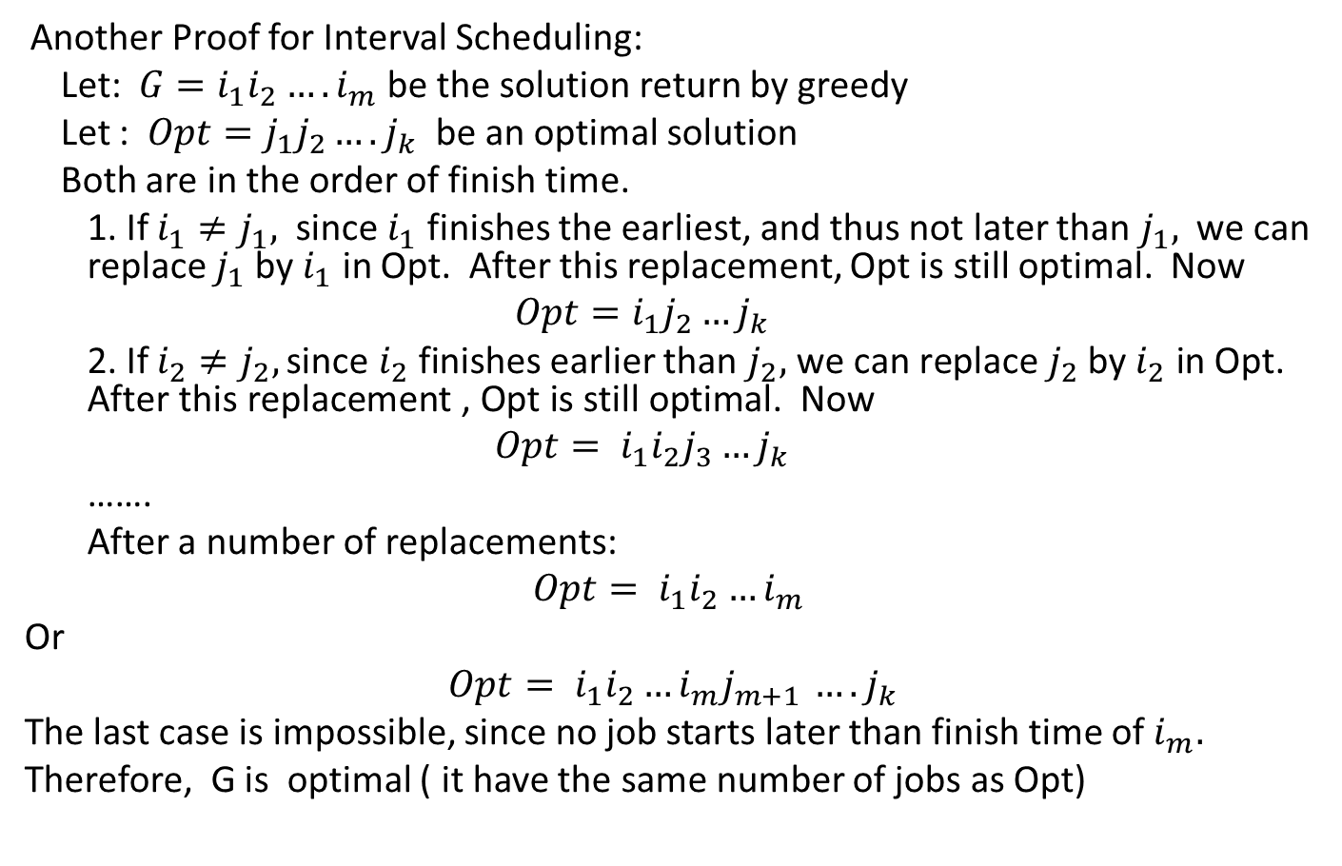
Another Proof for Interval Scheduling:
Let: $G=i_{1}i_{2}….i_{m}$ be the solution return by greedy
Let : $Opt=j_{1}j_{2}….j_{k}$ be an optimal solution
Both are in the order of finish time.
1. If $i_{1}≠j_{1},$ since $i_{1}$ finishes the earliest, and thus not later than $j_{1},$ we can replace $j_{1}$ by $i_{1}$ in Opt. After this replacement, Opt is still optimal. Now
$$Opt=i_{1}j_{2}…j_{k}$$
2. If $i_{2}≠j_{2}, \text{since} i_{2} \text{finishes}$ earlier than $j_{2}\text{, }\text{we} \text{can} \text{replace} j_{2} \text{by} i_{2} \text{in} \text{Opt}\text{. }\text{After} \text{this} \text{replacement}\text{ , }\text{Opt} \text{is} \text{still} \text{optimal}\text{. }\text{Now}$
$$Opt= i_{1}i_{2}j_{3}…j_{k}$$
…….
After a number of replacements:
$$Opt= i_{1}i_{2}…i_{m}$$
Or
$Opt= i_{1}i_{2}…i_{m}j_{m+1 }….j_{k}$
The last case is impossible, since no job starts later than finish time of $i_{m}.$
Therefore, G is optimal ( it have the same number of jobs as Opt)

Slide 16
Interval Scheduling
B
C
A
E
D
F
G
H
Time
0
1
2
3
4
5
6
7
8
9
10
11
B
0
1
2
3
4
5
6
7
8
9
10
11

Slide 17
Interval Scheduling
B
C
A
E
D
F
G
H
Time
0
1
2
3
4
5
6
7
8
9
10
11
B
C
0
1
2
3
4
5
6
7
8
9
10
11

Slide 18
Interval Scheduling
B
C
A
E
D
F
G
H
Time
0
1
2
3
4
5
6
7
8
9
10
11
A
B
0
1
2
3
4
5
6
7
8
9
10
11

Slide 19
Interval Scheduling
B
C
A
E
D
F
G
H
Time
0
1
2
3
4
5
6
7
8
9
10
11
B
E
0
1
2
3
4
5
6
7
8
9
10
11

Slide 20
Interval Scheduling
B
C
A
E
D
F
G
H
Time
0
1
2
3
4
5
6
7
8
9
10
11
B
D
E
0
1
2
3
4
5
6
7
8
9
10
11

Slide 21
Interval Scheduling
B
C
A
E
D
F
G
H
Time
0
1
2
3
4
5
6
7
8
9
10
11
B
E
F
0
1
2
3
4
5
6
7
8
9
10
11

Slide 22
Interval Scheduling
B
C
A
E
D
F
G
H
Time
0
1
2
3
4
5
6
7
8
9
10
11
B
E
G
0
1
2
3
4
5
6
7
8
9
10
11

Slide 23
Interval Scheduling
B
C
A
E
D
F
G
H
Time
0
1
2
3
4
5
6
7
8
9
10
11
B
E
H
0
1
2
3
4
5
6
7
8
9
10
11

Slide 24
Interval Partitioning

Slide 25
Interval Partitioning
Interval partitioning.
Lecture j starts at s_{j} and finishes at f_{j}.
Goal: find minimum number of classrooms to schedule all lectures so that no two occur at the same time in the same room.
Ex: This schedule uses 4 classrooms to schedule 10 lectures.
e
j
c
d
g
b
h
a
f
i
9
9:30
10
10:30
11
11:30
12
12:30
1
1:30
2
2:30
3
3:30
4
4:30
Time

Slide 26
Interval Partitioning
Interval partitioning.
Lecture j starts at s_{j} and finishes at f_{j}.
Goal: find minimum number of classrooms to schedule all lectures so that no two occur at the same time in the same room.
Ex: This schedule uses only 3.
c
d
f
j
b
g
i
a
e
h
9
9:30
10
10:30
11
11:30
12
12:30
1
1:30
2
2:30
3
3:30
4
4:30
Time

Slide 27
Interval Partitioning: Lower Bound on Optimal Solution
Def. The depth of a set of open intervals is the maximum number of overlapped lectures during the whole period.
Key observation. Number of classrooms needed ≥ depth.
Ex: Depth of schedule below = 3 ⇒ schedule below is optimal.
Q. Does there always exist a schedule equal to depth of intervals?
a, b, c all contain 9:30
c
d
f
j
b
g
i
a
e
h
9
9:30
10
10:30
11
11:30
12
12:30
1
1:30
2
2:30
3
3:30
4
4:30
Time

Slide 28
Interval Partitioning: Greedy Algorithm
Greedy algorithm. Consider lectures in increasing order of start time: assign lecture to any compatible classroom (Don’t open any new classroom unless necessary).
Implementation. O(n log n).
For each classroom k, maintain the finish time of the last job added.
Keep the classrooms in a priority queue.
Sort intervals by starting time so that s₁ ≤ s₂ ≤ ... ≤ s_{n}.
d ← 0
for j = 1 to n {
if (lecture j is compatible with some classroom k)
schedule lecture j in classroom k
else
allocate a new classroom d + 1
schedule lecture j in classroom d + 1
d ← d + 1
}
number of allocated classrooms

Slide 29
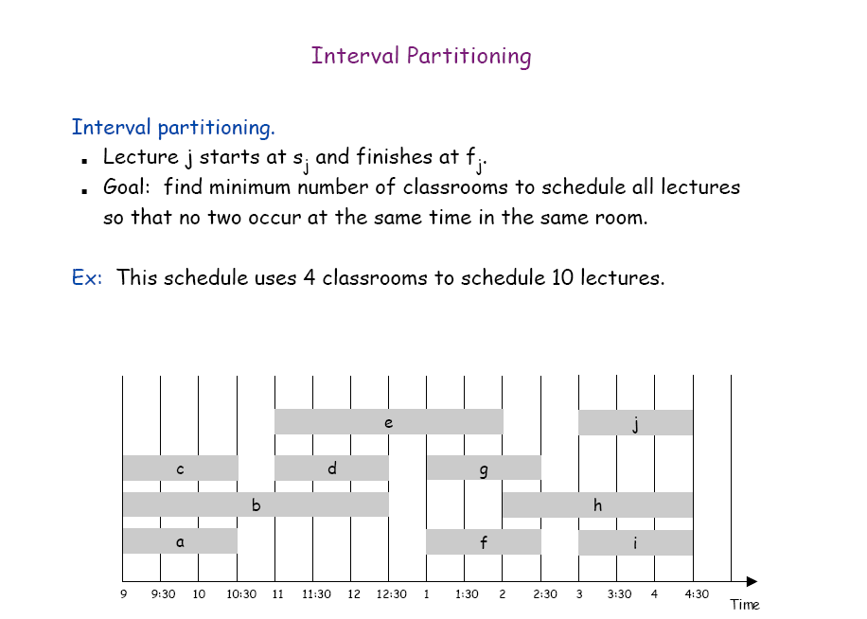
Greedy Algorithm:
c
d
g
j
b
f
i
Depth: The maximum No. of jobs required at any time.
a
e
h
Depth:3

Slide 30
Interval Partitioning: Greedy Analysis
Observation. Greedy algorithm never schedules two incompatible lectures in the same classroom (its solution is always feasible).
Theorem. Greedy algorithm is optimal.
Pf.
Let d = number of classrooms that the greedy algorithm allocates.
Classroom d is opened because we needed to schedule a job, say j, that is incompatible with all d-1 other classrooms.
Since we sorted by start time, all these incompatibilities are caused by lectures that start no later than s_{j}.
Thus, we have d lectures overlapping at time s_{j} .
d≤depth
Key observation ⇒ all schedules need to use ≥ depth classrooms.

Slide 31
Greedy Analysis Strategies
Exchange argument. Gradually transform any solution to the one found by the greedy algorithm without hurting its quality.
Structural. Discover a simple "structural" bound asserting that every possible solution must have a certain value. Then show that your algorithm always achieves this bound.
Notes:
myopic
greed: "at every iteration, the algorithm chooses the best morsel it can swallow, without worrying about the future"
Objective function. Does not explicitly appear in greedy algorithm!
Hard, if not impossible, to precisely define "greedy algorithm."

